Slide 1

How mature is your HTTPS implementation ? By Renaud Dubois
Some of the latest news about HTTPS
01/12/2017

Slide 2
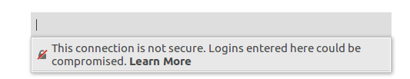
Introduction : Why https ?
Higher security & privacy than HTTP
Specially for sensitive data
Better Google ranking
Follow the initiative to make the web safer (initiatives such as Let’s encrypt, HTTPS everywhere)

Slide 3
HTTP only: main risks
Confidentiality
Credentials eavesdropping (login/password, cookies,..)
Data eavesdropping
Integrity
Data manipulation (injection – replacement) including on files downloaded
Dynamic code injection (Javascript)
…

Slide 4


Game
Be the first to right answer to the question and win some gift
The slides where a gift is available are pinned

Slide 5




HTTP threats→ let’s see in practice (1/3)
Passive spoofing/eavesdropping with a Rogue Access WiFi Point
Passive spoofing from a network or telecom equipment
HTTP
Man-in-the-middle (e.g. based ARP poisoning in IPv4; fake RA in IPv6)
HTTP
HTTP

Slide 6
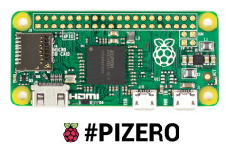
HTTP threats→ let’s see in practice (2/3)
Cookie based credentials hijack (e.g. via PoisonTap and Raspberry Pi Zero)
HTTP
USB cable
Emulate Ethernet device over USB
Run DHCP, DNS Server
Hijack all internet traffic
Allow leaking over HTTP request and catching user’s cookie
Force HTTP traffic (even for HTTPS website)
Grab the users' cookie (if the website runs without HSTS or if ‘Secure flag’ is not enabled on the cookies)

Slide 7





HTTP threats
What can a bad guy concretely do ?
Injecting content in the html pages
Redirect to a phishing website
Stealing login/password
Stealing existing session (cookie)
Replacing downloaded files (by malware)

Slide 8
HTTPS implementation 1/2
HTTPS GET /authentication
Partial HTTPS implementation limited to the login page (year ‘90)
HTTP GET /content
Secure architecture ??
Insufficient and still unsecure
Eavesdropping still possible of the session after authentication with the HTTP content (cookie)

Slide 9
HTTPS implementation 2/2
HTTPS GET /authentication
HTTPS GET /content
Full HTTPS implementation
Mitigate passive spoofing
Secure architecture ??
Doesn’t always mitigate MITM attack → Downgrade attack to HTTP often still possible in some cases

Slide 10
HTTPS implementation demo let’s see in practice
Demo

Slide 11
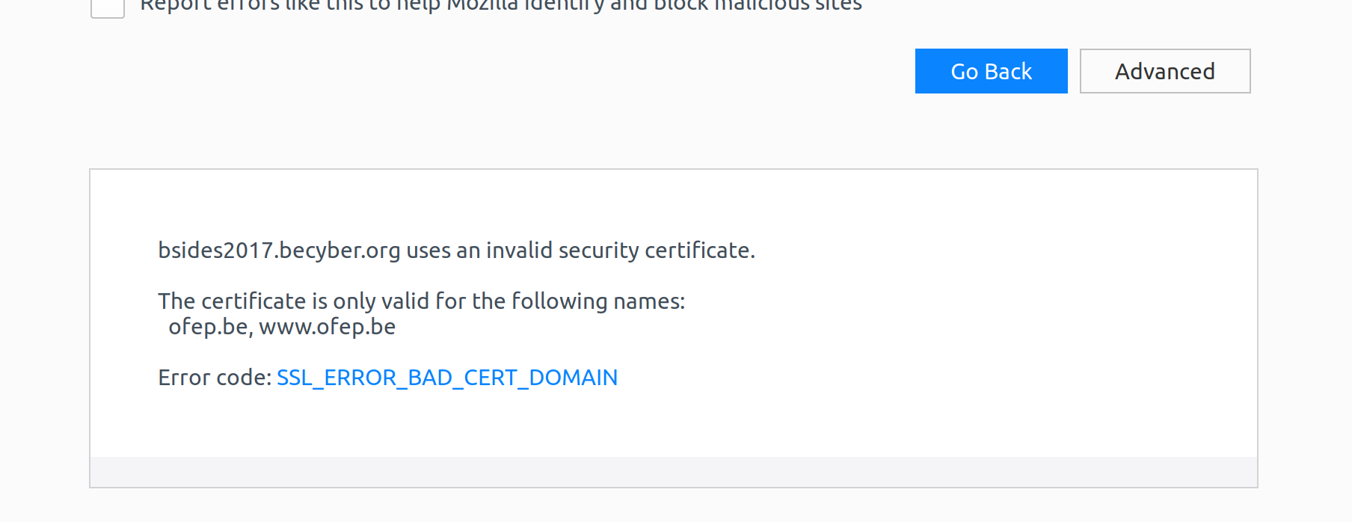
HTTPS with HSTS
HTTPS GET /
HTTPS: Strict-Transport-Security: max-age=<in seconds>
HTTP Strict Transport Security
Force the browser to always connect in HTTPS
To use in combination with a HTTP redirect (http → https)
Future request to the domain uses HTTPS (until expiration)
In case the connection cannot be established, an error is shown by the browser and the site stays inaccessible
The users cannot “bypass” an invalid certificates (no button “Add Exception”)
Mitigate passive spoofing
Mitigate cookie based credentials hijack
Mitigate some MITM attack on HTTPS

Slide 12
HTTPS with HSTS: in details
For specific domains/subdomain or for all subdomains (*.mydomain.com)
Good practice: implement HSTS for www.domain.com and domain.com
Strict-Transport-Security: max-age=63072000 [[;includeSubDomains]; preload]
Setting includeSubDomains on www.mydomain.com also applied for subdomains (e.g. app1.mydomain.com)
Be careful: could impact sites on subdomain that are not yet HTTP enabled
Preloaded list available in the browsers (Chrome, Firefox, Opera, Safari, IE 11 and Edge) https://hstspreload.org/
→ Mitigate the possible attack on the first connection and the time based attacks

Slide 13
HTTPS with HSTS: in details
Considered as « HIGH » security benefit by the Web Security Mozilla Sheet
Recommended « max-age » final value: 2 years (63072000 seconds)
How to still MITM websites using HSTS not part of the preload list ?
First connection remains unprotected (with a risk of a downgrade attack and stripping the HSTS header)
Vulnerable to time based attacks (e.g. false NTP packet)
Privacy:
“Supercookie” could lead to privacy issues
<img src=http://a.mydomain.com/pic.jpg »> → required HTTPS in future = Y
<img src=http://b.mydomain.com/pic.jpg »> → required HTTPS in future = N
<img src=http://c.mydomain.com/pic.jpg »> → required HTTPS in future = Y
<img src=http://d.mydomain.com/pic.jpg »> → required HTTPS in future = Y

Slide 14
HTTPS with HSTS: incognito mode
HSTS is supported by all the recent versions of browser (incl. IE on Win 7 with KB3058515)
Status of the browser and HSTS « Normal mode » vs « Incognito/Private mode »
→ Privacy vs Security
Browser | Shared between normal & private mode
Firefox 56 | No
Internet Explorer 11 (KB3058515) | No
Chrome 61 | Yes
Safari 11 | Yes
Browser | Shared between 2 private mode sessions
Firefox 56 | Yes
Internet Explorer 11 (KB3058515) | No
Chrome 61 | Yes
Safari 11 | Yes

Slide 15
OCSP: Introduction
Client must verify the validity of the server certificate
CRL → huge list → latency to download
OCSP (Online Certificate Status Protocol) → more lightweight
→ extra OCSP request to a 3d party OCSP responder

Slide 16
OCSP: Presentation
Regular OCSP browser validation
DNS server mydomain.com
DNS query mydomain.com
DNS query ocsp.ca.com
HTTPS GET mydomain.com
Web server mydomain.com
HTTP OCSP check
CA SSL mydomain.com
OCSP Responder

Slide 17
OCSP: Presentation
Privacy issue: the CA can potentially track the websites you visit
What does the browser in case of a timeout from the OCSP Responder ?
Stop ? Availability risk (DoS)
Continue ? Confidentially/integrity risk
What does Firefox (v 56.0) do today ?
By default, Firefox currently continues the connection.

Slide 18
OCSP Stapling : Presentation
OCSP stapling browser validation
« OCSP-must-staple »
DNS server mydomain.com
DNS query mydomain.com
DNS query ocsp.ca.com
HTTPS GET mydomain.com
Web server mydomain.com
Server retrieves OCSP record, put it in cache and serve it to clients directly
Check that the server certificate is not revoked using a unique SSL communication
OCSP check
CA SSL mydomain.com
OCSP Responder

Slide 19


HPKP : Presentation
HTTP Public Key Pinning Extension
Without HPKP the browser will trust all the certificates signed by a CA present in the browser store when establishing a TLS connection
With HPKP the browser will ONLY trust a list of pre-defined set of ‘pinned’ public keys
HTTPS GET /
Tampered
Unauthorized SSL certificate (from a compromised CA)
Legitimate SSL certificate

Slide 20
Fraudulent certificates – known cases
Most popular cases:
2011 - GlobalTrust.it hacked – 9 fraudulent certificates generated
2011 - DigiNotar (NL) hacked - more than 500 fraudulent certificates generated
2014 - National Informatics Centre of India – several fraudulent certificates (google) generated
2015 - CNNIC (CN) – unauthorized digital certificates for several Google domains

Slide 21
HPKP : Presentation
Mitigate MITM attack with forged certificates
Detection of unauthorized certificate (from an compromised CA) AFTER the first connection
Public-Key-Pins-Report-Only: pin-sha256="base64=="; max-age=expireTime [; includeSubDomains]; report-uri="reportURI"
At least one backup key must be pinned (in case current public key must be replaced → certificate revoked)
Alerting mechanism with the optional “report-uri” to report forbidden public keys
POST a “violation report” in JSON format
Only supported by few browsers
Possibility to “pin” the keys of Root and intermediate CA

Slide 22


HPKP : Presentation
Preloaded list exists (built-in in the browser) but no submission pages
What about HPKP and “outbound” SSL decryption ?
HTTPS GET mydomain.com
Request SSL connection
Firewall sends its own dynamically generated certificate
Servers sends certificate
Browser should ignore the pinning in case of CA installed
Shouldn’t conflict with « SSL decryption » (on NGFW/Forward proxy) implementation to inspect outgoing surf traffic
Firefox: security.cert_pinning.enforcement_level = 1
0. Pinning disabled
1. Allow User MITM (pinning not enforced if the trust anchor is a user inserted CA, default)
2. Strict. Pinning is always enforced.
3. Enforce test mode.

Slide 23
HPKP : Presentation
Limitations:
Not supported by every browser such as Safari, IE11, Edge (under consideration),;
Supported by Firefox (>35), Chrome, Opera, Android
First connection remains unprotected (TOFU)
Hostile Pining: could be misused by a bad guy to block the access to your website (and ask ransom?)
The bad guy insert a HPKP header with his own public key and with a high ‘max-age’ value
The visitor got an error message and will not be able to visit the website until expiration of the ‘max-age’
Impact still occurs after the header has been corrected (persistent in the browsers)
Browsers decides of the maximum ‘max-age’ value – no RFC standard
Can only occur with HTTPs (not HTTP)
Privacy concern (super cookie)
Mozilla recommendation “Mandatory for maximum risk sites only - Not recommended for most site”

Slide 24
HTTPS protocols/ciphers suite/signature algorithms
Protocols
TLS 1.3/1.2/1.1/1.0/SSLv3/SSLv2
Ciphers Suites
Certificates and signature algorithms (e.g. SHA256)
Perfect Forward Secrecy (PFS)
Encrypted recorded communications in the past cannot be decrypted
Intercepted today decrypted tomorrow ?
Attribute of the specific key exchange mechanisms
Diffie-Hellman Ephemeral (DHE) or Elliptic Curves (ECDHE)

Slide 25
Certificate Transparency: Presentation
Background
Fraudulent certificates takes time to be detected and revoked by browser vendors
Certificate Transparency logs
Certificate Transparency monitors
Certificate Transparency auditors

Slide 26
DNS CAA
How does it work ?
Use DNS entries to allow a CA to generate certificates for a domain
No check at the client (e.g. browser side → DANE)
The CA/Browser Forum decided every CA must support DNS CAA checking for 09/2017
Not always supported by widely used DNS providers (e.g. OVH,..) – recently added into cPanel and into AWS Route 53
Advantages
Implementation
example.com. CAA 0 issue “entrust.com"
CAA 0 issue "letsencrypt.org“
CAA 0 issuewild "entrust.com"
CAA 128 iodef "mailto:security-incident@example.com"
beta.example.com CAA 0 issue “digicert.com"

Slide 27

Current HTTPS implementations in Luxembourg
Let’s see the statistics
Top 60 country Luxembourg TLD .lu in October 2017 (source Alexa.com)
HSTS
HPKP
OCSP Stapling
DNS CAA
Forward secrecy
Ciphers

Slide 28
Current HTTPS implementations in Luxembourg

Slide 29
Current HTTPS implementations in Luxembourg
How many % of websites have implemented HSTS ?
95% of HTTPS servers vulnerable to trivial MITM attacks
Source: Netcraft (03/16)
Editus.lu
Ing.lu
Restena.lu
Mobiliteit.lu
Yellow.lu
Hornbach.lu
Lesfrontaliers.lu
secure.banquebcp.lu
Orange.lu

Slide 30
Current HTTPS implementations in Luxembourg
Not really a surprise: only 0.09% of the certificates in Netcraft's March 2016 SSL Survey are served with HPKP headers, which equates to fewer than 4,100 certificates in total.
Source: Netcraft (03/16)

Slide 31
Current HTTPS implementations in Luxembourg
Jobs.lu
Pwc.lu

Slide 32
Current HTTPS implementations in Luxembourg
Immotop.lu
Vdl.lu

Slide 33
Current HTTPS implementations in Luxembourg

Slide 34
Current HTTPS implementations in Luxembourg

Slide 35


Slide 36
Let’s now discuss together about it
Webmasters
HTTP or HTTPS website
HSTS implementation status
Preload list
Implementation issues
Victim of target attacks
DNS CAA implementation status
OCSP stapling implementation status

